Slide 1
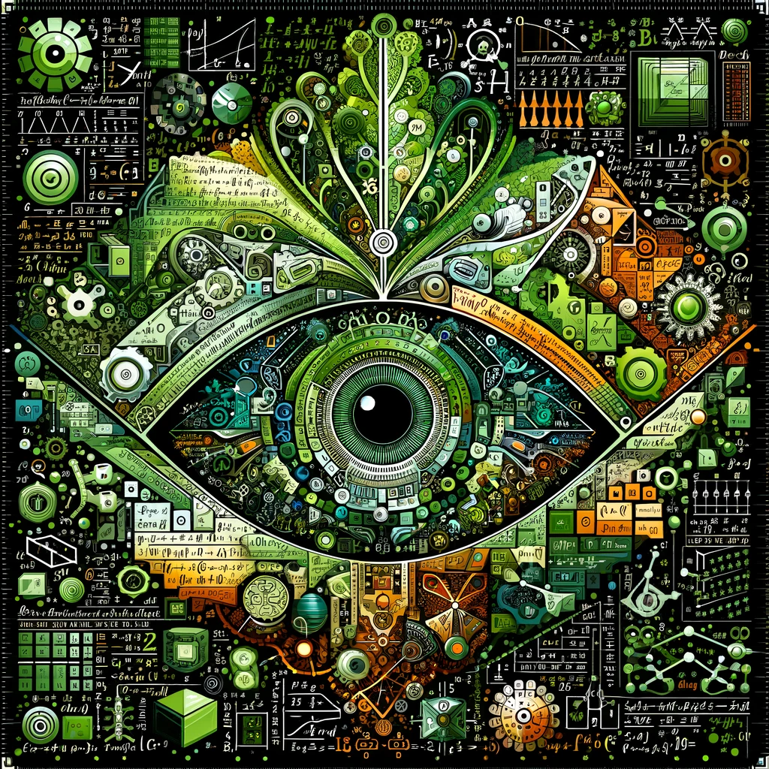
AGENDA
ABOUT THIS INITIATIVE
AI HISTORY
AI DICIPLINES
MACHINE LEARNING – ML
TRANFORMERS AND GPT
DEMO & DISCUSSION
JUPYTER
PYTHON
CONSLUSIONS

Slide 2
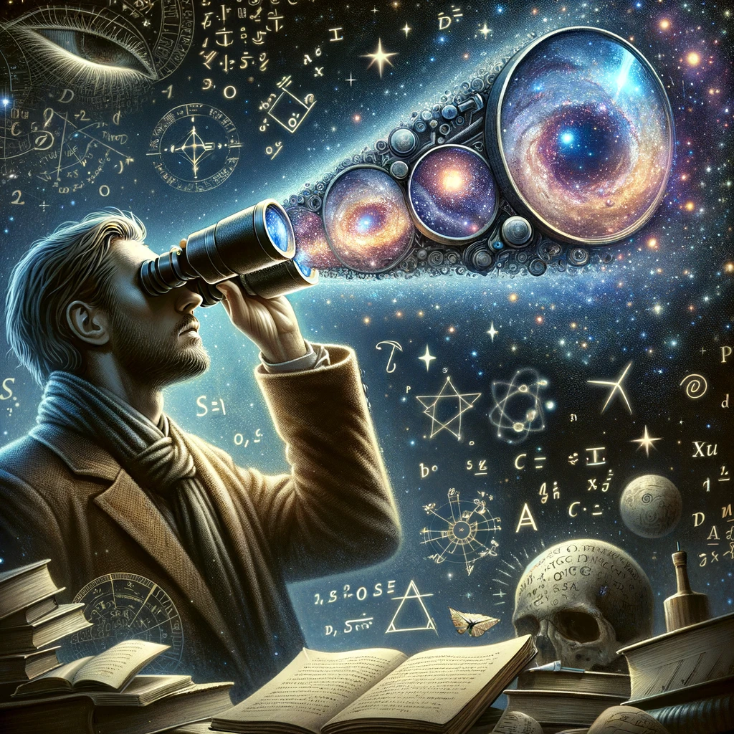
ABOUT THIS INITIATIVE
Why, How and what
Fun and entertainment
Machine Learning step by step
Implement using python
Understand the mathematics
Hands on with real datasets
Supervised Learning & Neural Networks
Setup
Regression – Work in progress
Classification – Work in progress
Transformers
GPT

Slide 3
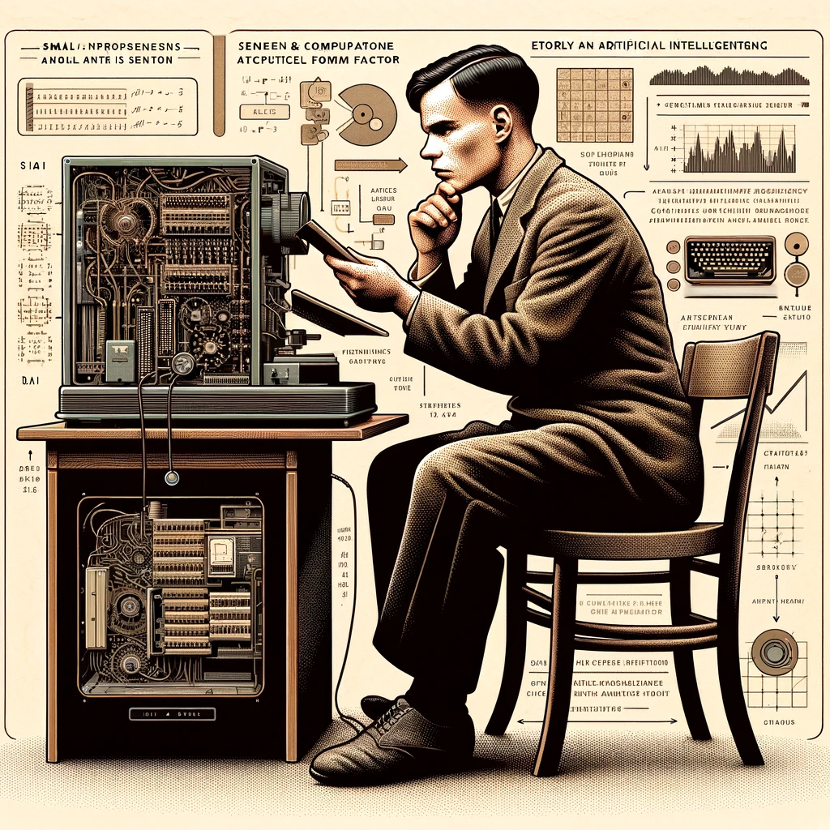
MILESTONES / HISTORY
Alan Turing (1936-2012) was the first person to conduct substantial research in the field
Artificial intelligence was founded as an academic discipline in 1956 (Conference at Dartmouth College)
Many years of ups and downs with cycles of optimism and funding (AI winter ).
1990's Expert systems - now more broadly replaced by Machine learning and Neural Networks
Deep learning boom after 2012 surpassing all previous AI techniques
In 2017 transformer architecture has led to today's boom and hype
What's next?

Slide 4
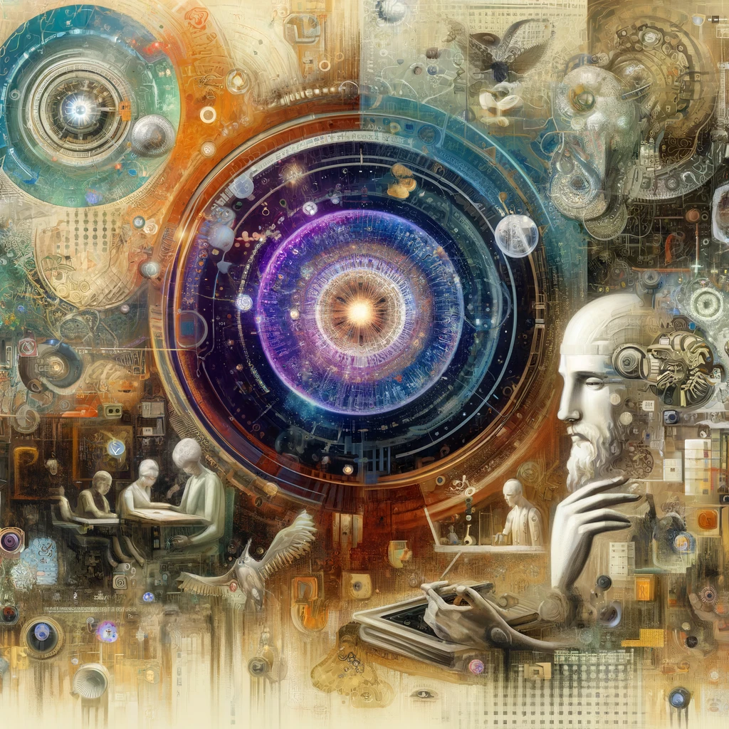
DICIPLINES
Machine Learning
Focuses on developing algorithms that allow computers to learn from and make predictions or decisions based on data. Machine learning
Robotics
Integrates AI algorithms into physical devices, allowing them to perform tasks autonomously or semi-autonomously. Robotics applies AI in fields like manufacturing, healthcare, and exploration.
Computer Vision
Involves teaching computers to interpret and understand the visual world. This discipline enables applications like facial recognition, object detection, and autonomous vehicles.
Cognitive Computing
Aims to simulate human thought processes in a computerized model, combining AI with cognitive science to create systems that mimic human reasoning and problem-solving capabilities.
Neuroscience and AI
Studies the human brain to inspire the development of AI systems. This includes understanding how neural networks in the brain process information to improve artificial neural networks.
Other
Besides this there is a mix of philosophy AI hybrid disciplines. Also, some parts of Big Data and Human Computer Interaction (HCI) can be attributed as AI.

Slide 5
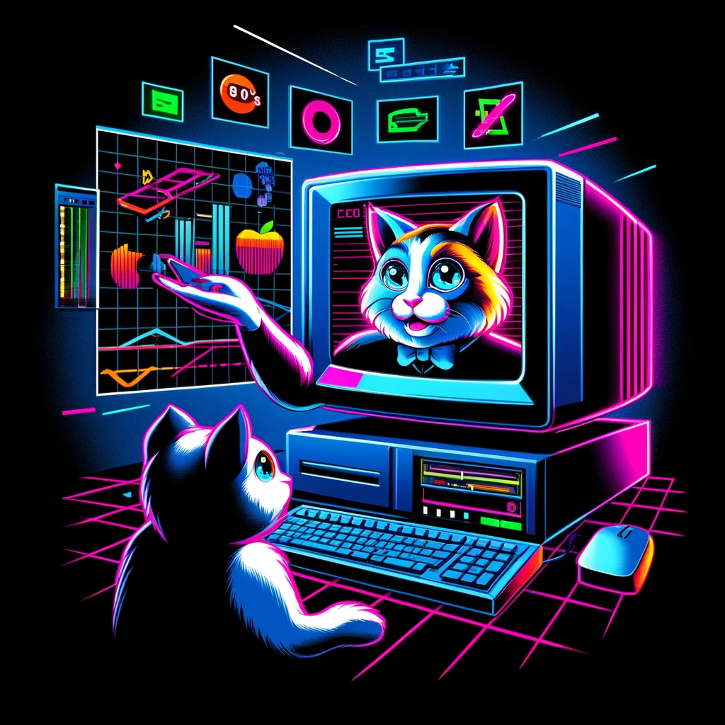
MACHINE LEARNING
Supervised learning - requires a human to label the input data first, and comes in two main varieties:
Classification - where the program must learn to predict what category the input belongs in
Regression - where the program must deduce a numeric function based on numeric input
Unsupervised learning - analyzes a stream of data and finds patterns and makes predictions without any other guidance.
Reinforcement learning - learning the agent is rewarded for good responses and punished for bad ones. The agent learns to choose responses that are classified as "good".
Transfer learning - is when the knowledge gained from one problem is applied to a new problem.
Deep Learning - A subset of machine learning that involves neural networks with many layers.
Other – Many combinations and hybrid models also exist

Slide 6
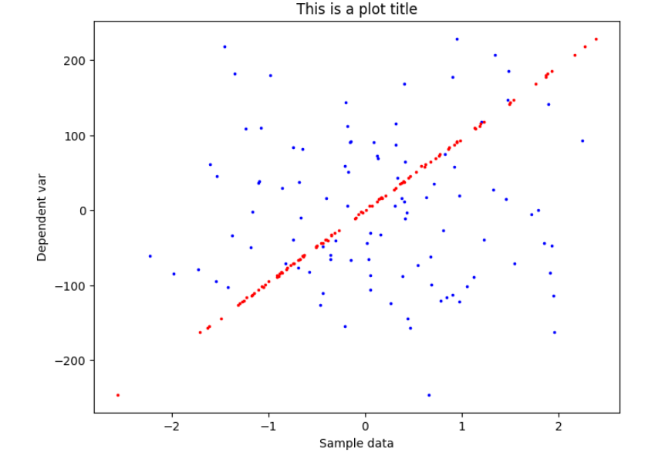
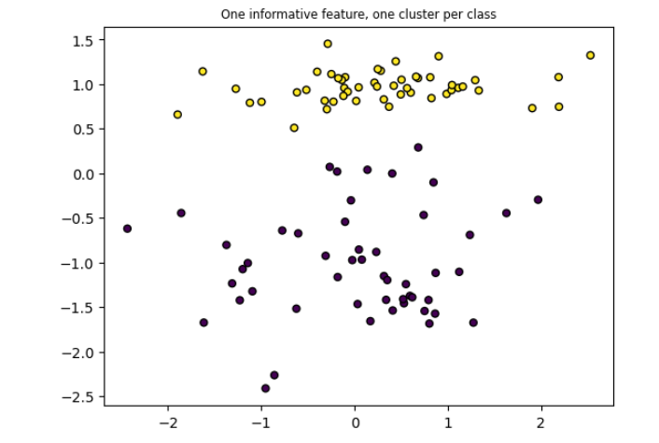
SUPERVISED LEARNING
Random dependent data
Two features
One Informative
Random data
Two Classes

Slide 7
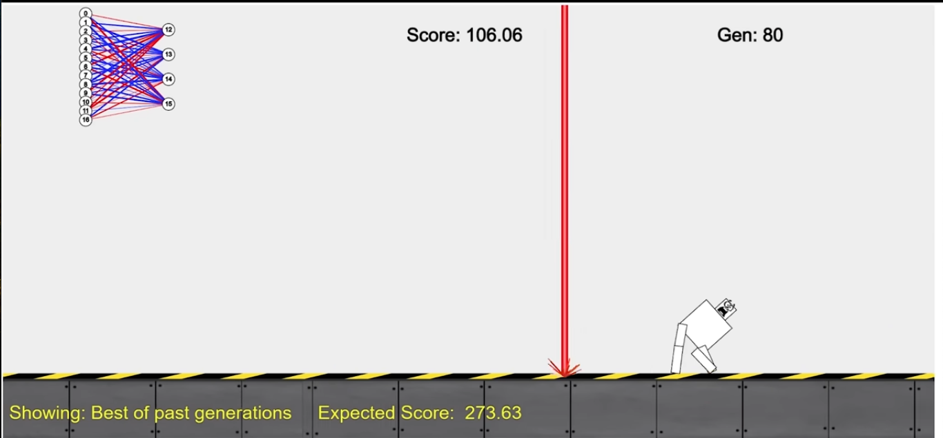
REINFOREMENT LEARNING – LEARNING TO WALK
Observation: The agent observes the current state of the environment.
Decision: Based on the observed state, the agent employs a policy to decide on an action.
Action: The agent performs the action, affecting the environment.
Reward: After the action is performed, the agent receives a reward from the environment.
Learning: The agent updates its policy based on the reward received and the new state of the environment.
https://youtu.be/K-wIZuAA3EY?si=iihBr3qzAQc0dsYi

Slide 8
CONSLUSIONS
Input?
Anyone investing free time?
What’s next?
https://github.com/erikhedb/

